Slide 1
Crop Recommendation using ML
Team No : 22 Team Members:
Nitin (2019181) Dhananjay (2019161)
Harsh (2019164) Ishaan (2019245)

Slide 2
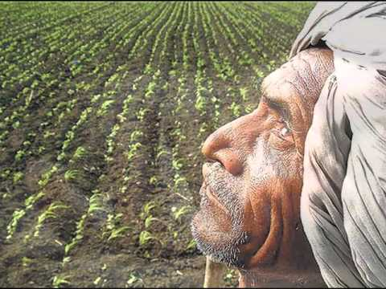
Motivation
India’s economy is vastly dependent upon the agricultural sector.
Due to increasing population , now it is more prominent to utilize our agricultural lands as efficiently as possible.
Choosing right crop for an agricultural land is very crucial. Due to the limited knowledge, it is sometimes difficult for the farmers to choose right crop for their field.
Due to the wrong choice of crop, farmers suffer a lot.
It becomes difficult for them to get any profit.
If the profit is less, it will be impossible for
farmers to expand their agriculture.

Slide 3
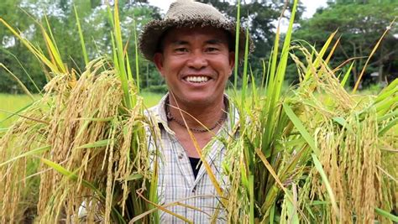
Motivation Continued...
Our Crop Recommender model will do this crucial selection of crop for a particular agricultural land.
Based upon the climatic conditions of an agricultural land (such as rainfall, humidity and temperature) and soil conditions ( such as pH level, NPK level), our model will predict the best crop which will give the highest yield if grown on the given agricultural land.
If the crop yield is high, then the
advancement of agricultural sector
in India will probably increases.

Slide 4
Literature Review
P. Priya, U.Muthaiah, M.Balamurugan, “Predicting yield of the crop using machine learning algorithm”, IJESRT International Journal of Engineering Sciences & Research Technology, Volume 7(4), April 2018.
In this study, researchers worked on the data set of Tamil Nadu from 1997 to 2013 and the various features are taken into account are rainfall, precipitation, production and temperature.
Random Forest algorithm was used to study the performance of this approach on the dataset as data overfitting is less of an issue with random forest algorithm.
Results show that we can attain an accurate crop yield prediction using the Random Forest algorithm as it achieves the largest number of crop yields with the lowest models and is suitable for for massive crop yield prediction in agricultural planning.

Slide 5
Literature Review Continued..
Aditya Shastry, H. A. Sanjay, and E. Bhanusree (2017)
In this paper, the researchers worked with supervised algorithms to forecast crop production.
The forecast is done mainly for crops : maize, cotton, wheat across different regions of India.
Multiple regression analysis of different degree is done for crop yield prediction.
The result of different regression models are compared using (R°), Root Mean Square Error (RMSE) and Mean Percentage Prediction Error (MPPE).
The model which gives lower Root Mean Squared Error, Prediction Error and higher R° statistics is considered to be the best model for the crop yield prediction.

Slide 6


Dataset Description
The features which is used are :
Rainfall in mm ` Nitrogen(N) level of soil.
Temperature in Celsius Phosphorous(P) level of soil.
Humidity Potassium(K) level of soil
pH level of soil Manganese(Mn) level of soil
Iron(Fe) level of soil Sulphur(S) level of soil
Calcium (Ca) level of soil Magnesium(Mg) level of soil
We have 12 features and 1 multiclass output label predicting the type of crop.

Slide 7
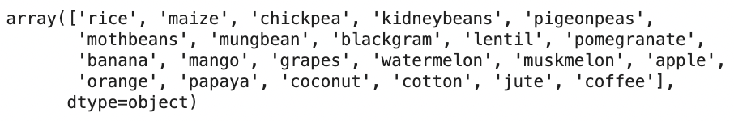
Dataset Description Continued...
Our output label is multiclass classification.
The dataset consists of 22 different class labels.
Our dataset consists of 69,718 data samples.
Glance of output labels :

Slide 8
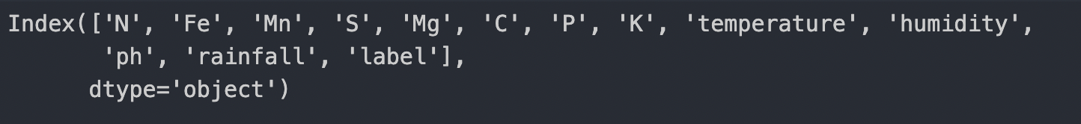
Dataset Description Continued...
Preprocessing done :
Removed unnecessary feature columns. Removing skewed feature if any.
Checked for null values Histogram plotting of each feature
Checked for duplicate data samples
Checked for correlated features using sns heat map.
Normalization of data.

Slide 9

Methodology
● Libraries used in code
● Pandas
● Numpy
● Seaborn
● Matplotlib
● sklearn
● Data Pre - Processing
● Normalization of data set for better performance.
● Displaying data information and description
● Feature selection by removing co-related/skewed columns
● Plotting histogram of each labels.

Slide 10
Methodology Continued..
● Relationship Analysis
● Correlation
● Plotting heatmap
● Plotting pairgrid
● Plotting Relational Plot
● Data distribution plot
● Plotting mean value of all features for each crop type
● Different Machine Learning Algorithms have been used and comparing results :
● Logistic regression, ● Decision tree with Adaboost
● Naive Bayes, ● Artificial Neural Network(MLP)
● Decision Tree, ● Support Vector Machine
● Random Forest

Slide 11
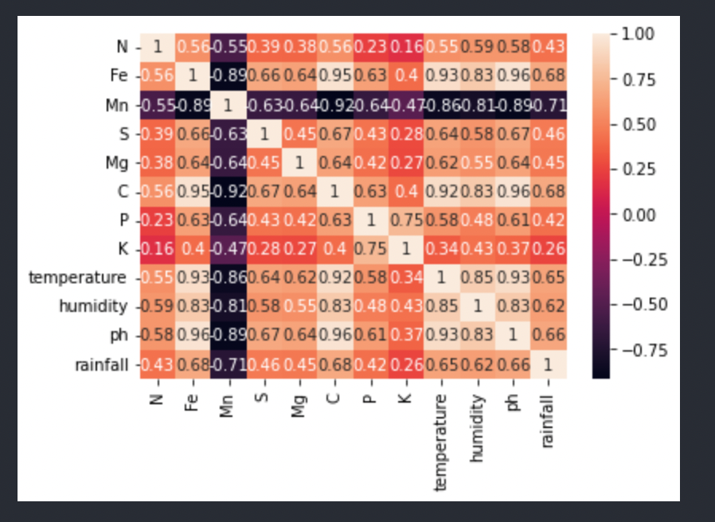
Results/Analysis/conclusion
● In dataset we don’t have null values
● In dataset we don’t have any repeated data
● Features are not skewed
● Heat map plot for
Correlation :

Slide 12
Results/Analysis/conclusion Continued..
Accuracy of Different Models
● Logistic Regression : 77.68%
● Decision Tree : 72.83%
● Decision Tree with Adaboost : 89.58%
● Random Forest : 92.6%
● Naive Bayes : 39.06 %
● Artificial neural networks : 98.38 %
● Support vector machine : 96.91 %

Slide 13
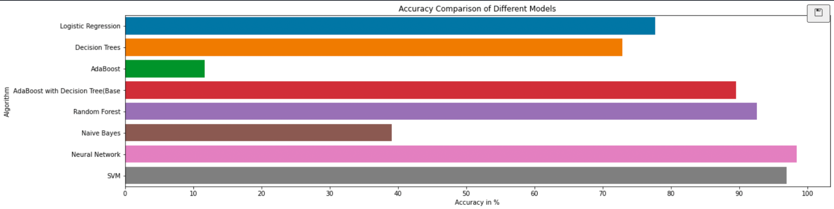
Results/Analysis/conclusion Continued..

Slide 14
Results/Analysis/conclusion Continued..
From the Accuracy plot we can infer that
Naive-bayes has least accuracy, around 40 % . This is because naive bayes assume independency of features which is not a case in practical scenario.
Logistic Regression performs okay-ish (77%).
Decision Tree has less accuracy(72%) than Random Forest (92%) / Decision Tree with adaboost(90%) as it is generally the case that Decision Tree overfit our training data.
Neural Network(98%) and SVM(96%) perform very well and it is quite reasonable due to their complexity and they are strong classifiers.
The best model is Neural Network having accuray of 98%. On the other hand it has high complexity .
Our optimal model is : 1) Neural network complexity is not an issue.
2) SVM is relatively less complex and has slightly less accuracy than neural network

Slide 15
Timeline
September:
● Data Extraction and Filtering Features.
● Data Preprocessing.
October
● Exploratory data analysis.
● Applying different models.
November:
● Classification and Data Training
● Choosing the appropriate type of learning.
December:
● Analyzing Accuracy among all models and reasoning for the best output.

Slide 16
Individual team member’s contributions
Harsh:
Finding dataset, data extraction, dataset cleaning, making presentation, Logistic Regression, Random Forest, Support Vector Machine, MLP.
Nitin:
Project Idea, EDA, data preprocessing and normalization of data, plotting graph, making presentation, comparing model accuracy, Support Vector Machine, MLP.
Dhananjay:
Project Idea, data extraction, dataset cleaning, report writing, Naïve Bayes, Decision Trees, Adaboost, Final Report.
Ishaan:
Finding dataset, EDA, plotting graphs, report writing, relationship analysis, Naïve Bayes, Decision Trees, Adaboost, Final Report.

Slide 17
References of Images
https://i.ytimg.com/vi/NW2y58eY6qY/hqdefault.jpg
https://ak.picdn.net/shutterstock/videos/33088480/thumb/1.jpg
https://www.thermofisher.com/blog/connectedlab/wp-content/uploads/sites/14/2020/01/istock-962219860-2-scaled.jpg
Source Code

